Slide 1
Predicting Monster
Challenge Ratings in
Dungeons and Dragons
Project 4
GROUP FIVE

Slide 2
01
The Idea

Slide 3
Project Overview
01
BACKGROUND
03
HOW IT’S DONE
Dungeons & Dragons (D&D) is a collaborative role-playing game (RPG) where players work together to tell a story in a fantasy world, playing as fantasy heroes to fight monsters, grow stronger, and work through a story told by the Dungeon Master (DM).
Exploratory data analysis using Pandas, Matplotlib, Seaborn
Data Cleaning
ML Model Optimization
Results / Deployment
02
THE GOAL
04
OUTCOMES
Our group wants to create a machine learning model that can give a designated monster a Challenge Rating (CR) based on the monster's attributes, such as hit points (HP), Speed, attacks and abilities.
If time allows, this information will then be used to determine the effective CR of custom monsters created by the model’s users, as an aid for DM’s to better fine-tune their stories and monster encounters for their players.

Slide 4
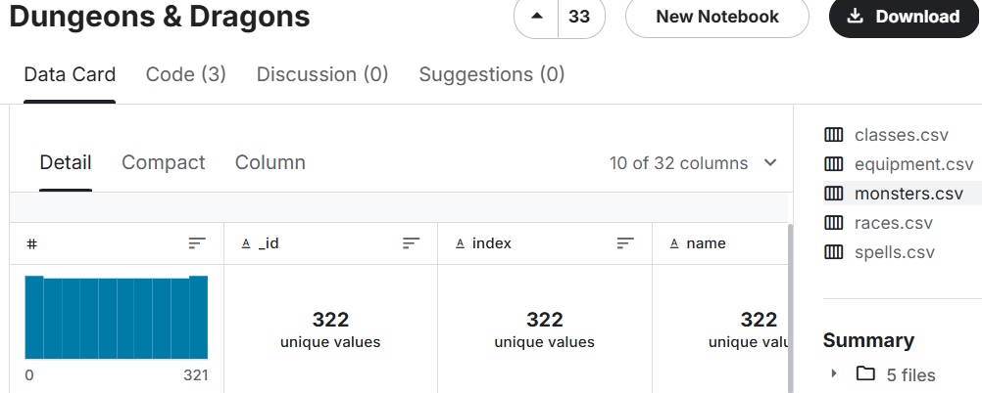
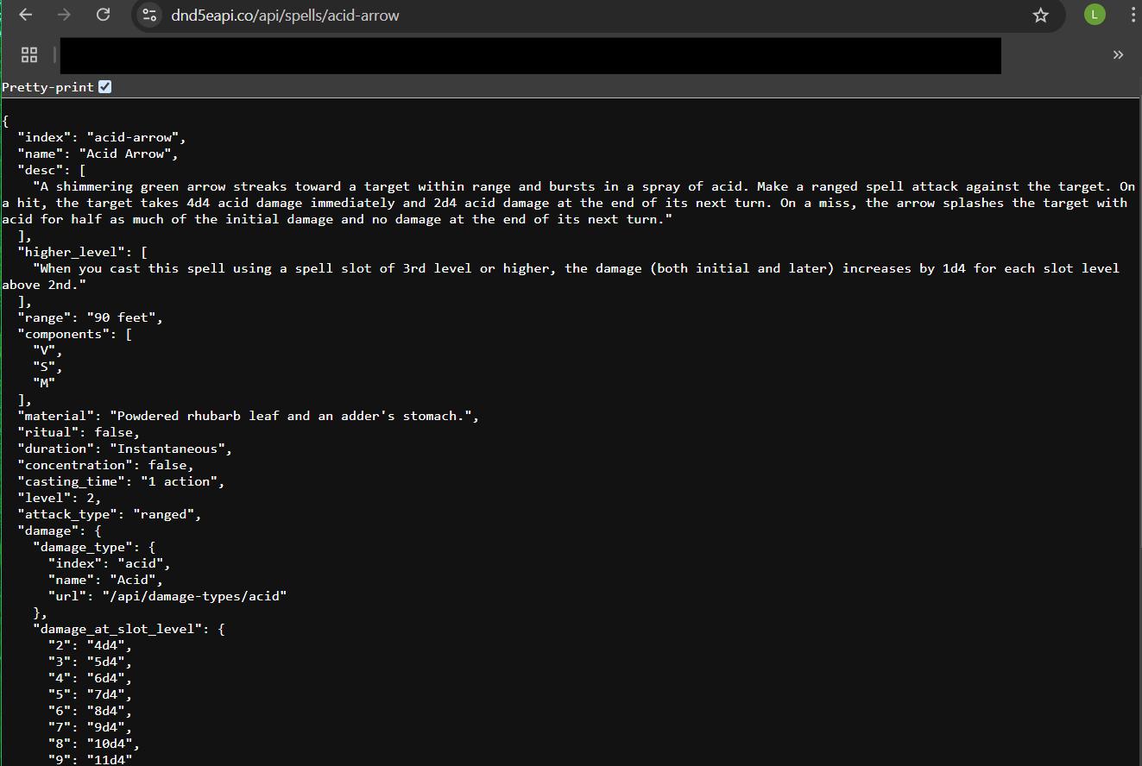
The Data
We used two resources to pull information for this project:
-Kaggle Dataset: https://www.kaggle.com/datasets/shadowtime2000/dungeons-dragons?select=monsters.csv
Contained 5 CSV’s about Monsters, Equipment, Race, Classes, and Spells
Mainly focused on the Monsters CSV, which contains 322 unique monster records
-DND API:
https://www.dnd5eapi.co/
This is the 5th edition Dungeons and Dragons API, the dataset above pulled information from this API

Slide 5
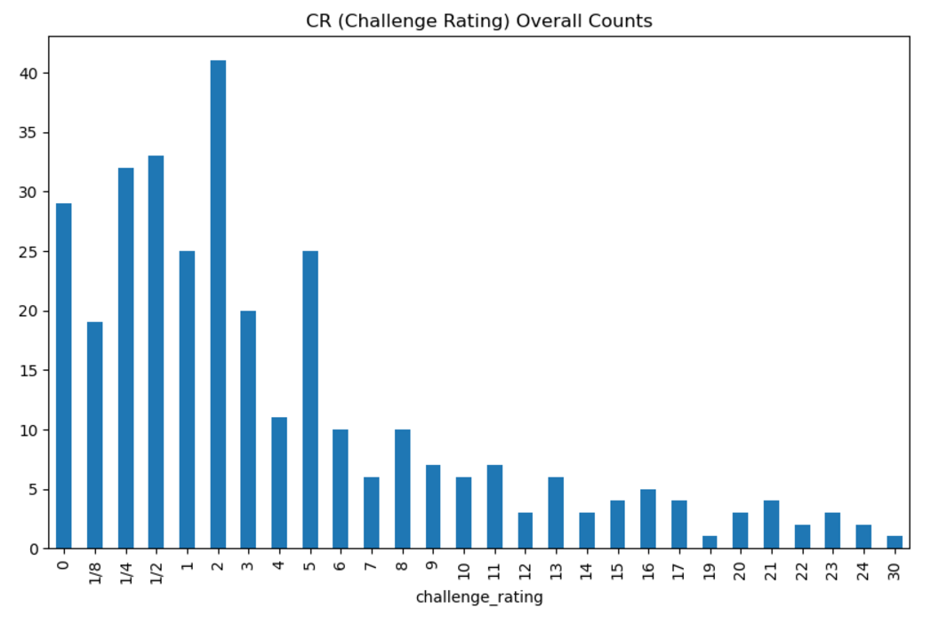
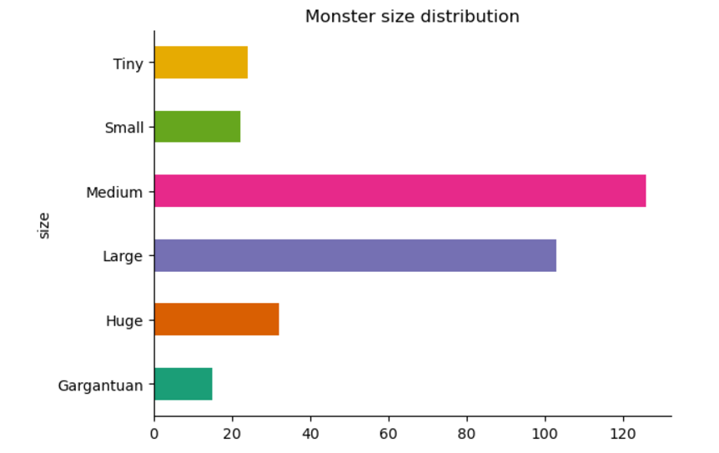
Exploratory Data Analysis Pt. 1
Prior to creating the machine learning model, we wanted to learn more about the data we had on hand.
We looked at overall Challenge Rating Counts across all monsters. The most common being 2, and least common being 19.
We also looked at Monster size distribution, to see what size was more or less common.
Medium and large sized monsters are fairly common, where as gargantuan accounts for less than 20 of the 322 monsters.
80
70
60
50
40
30
20
10
BAR GRAPH INFO 1
BAR GRAPH INFO 1
BAR GRAPH INFO 1
BAR GRAPH INFO 1

Slide 6
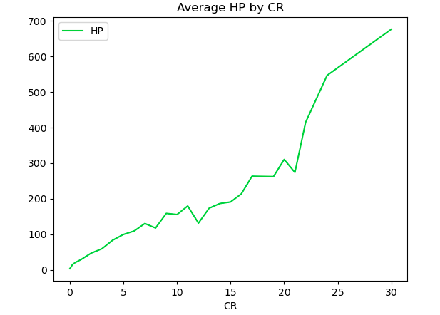
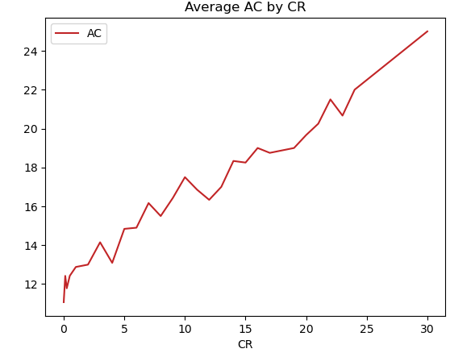
Exploratory Data Analysis Pt. 2
We looked at average Hit Points (HP) and average Armor Class (AC) by Challenge Rating (CR).
These features are essential to understanding the monsters durability and defense varies with their CR. The higher the CR the higher HP and AC are.
Both HP and CR increase as CR increases, but HP tends to scale more significantly. As monsters become stronger they can survive more damage.

Slide 7
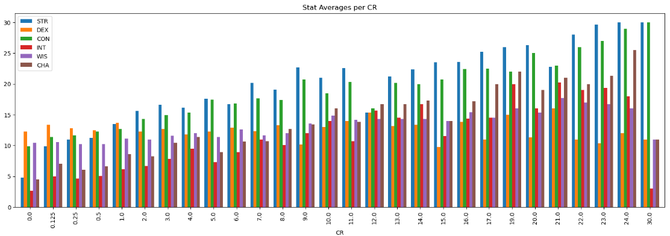
Exploratory Data Analysis Pt. 3
We can see that strength and constitution go up in average as challenge rating increases.
This is key information, since constitution is a measure of a character’s health, stamina, and vital force. Essentially it allows a character to withstand a lack of food, fight off disease/poison, and last longer during combat.
We also wanted to see what the stat averages were for Monsters per their Challenge Rating.
We can also see that dexterity tends to be the highest stat amongst lower challenge rated Monsters.
80
70
60
50
40
30
20
10
BAR GRAPH INFO 1
BAR GRAPH INFO 1
BAR GRAPH INFO 1
BAR GRAPH INFO 1

Slide 8
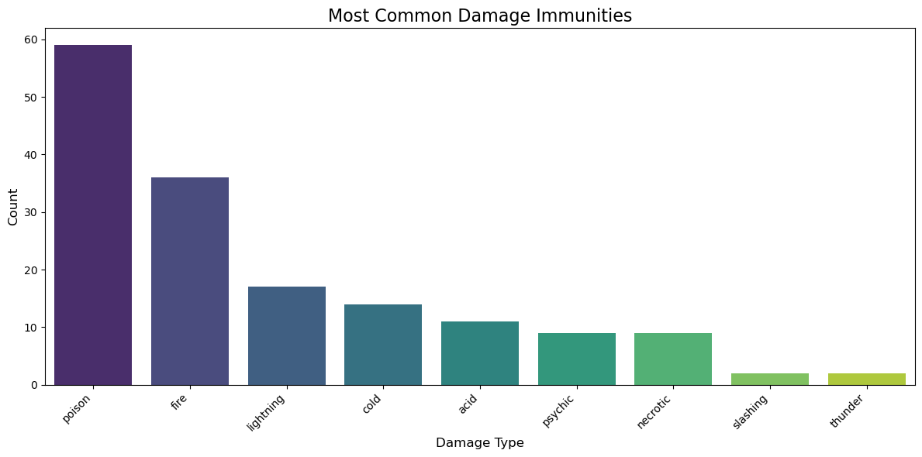
Exploratory Data Analysis
Why Analyze Distribution of Damage Immunities?
Game Balance Insight:
Knowing which damage types are frequently immune can help identify common monster traits, potentially influencing player strategy (e.g., avoid relying on fire attacks if "fire immunity" is very common).
Model Training:
When building a machine learning model, knowing the prevalence of damage immunities can guide feature selection (e.g., a highly common immunity like "poison" might carry less predictive power than rare ones).

Slide 9
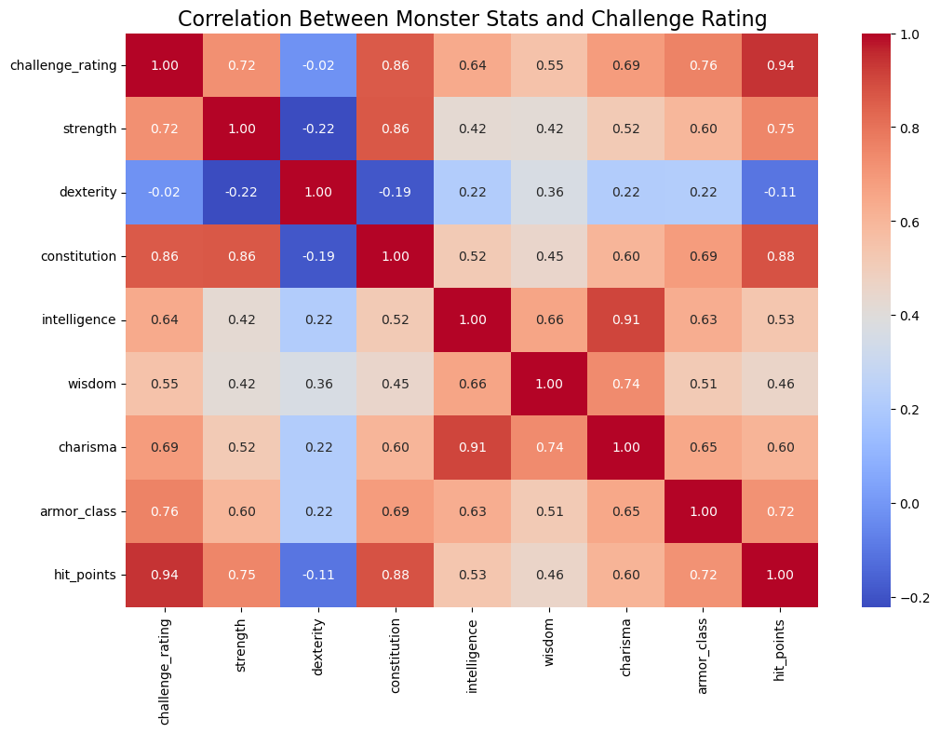
Exploratory Data Analysis
Correlation Heatmap for Attributes
Goal:
Identify relationships between monster stats (e.g., strength, dexterity) and challenge rating to inform ML model features.
How This Helps:
Identifies which attributes (e.g., strength, hit points) correlate strongly with challenge rating.
Features with strong correlations are likely to be important predictors in machine learning models.

Slide 10
02
Pre-processing the Data

Slide 11
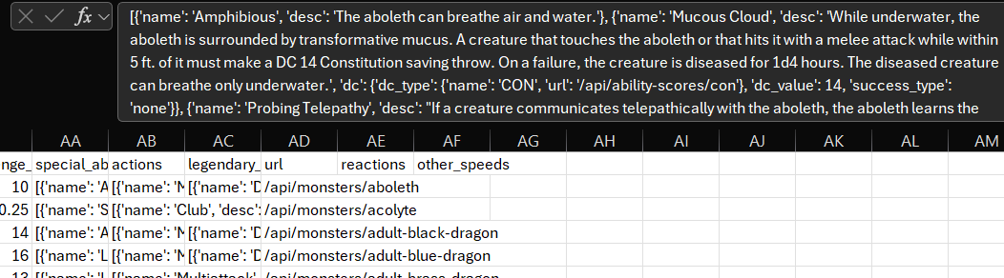
What the data
Looked like
Most machine learning models are based on numerical values, but not only did we have a majority of our data texted based, but it was concatenated in an odd manner.
Here’s an example:

Slide 12
How We Pre-processed The Data
COLUMN CUTTING
2. API STRING CLEANING
Removing duplicate or unneeded variables from the dataset (index codes, urls, languages)
Using regex and str.replace functions, the majority of text-based variables were stripped of excess punctuation, data labels and duplicate information present from pulling the information from the D&D API.
3. NULL VALUES + SQL
4. MODEL PREPROCESSING
Properly assigning null values to the various column types, after revealing them through step 2’s purge of empty data variables, then transferring the now-clean table to a SQL database.
The dataset’s features list were subdivided into numerical and categorical variables, then preprocessed with StandardScaler for the numerical variables and OneHotEncoder for the categorical variables.

Slide 13
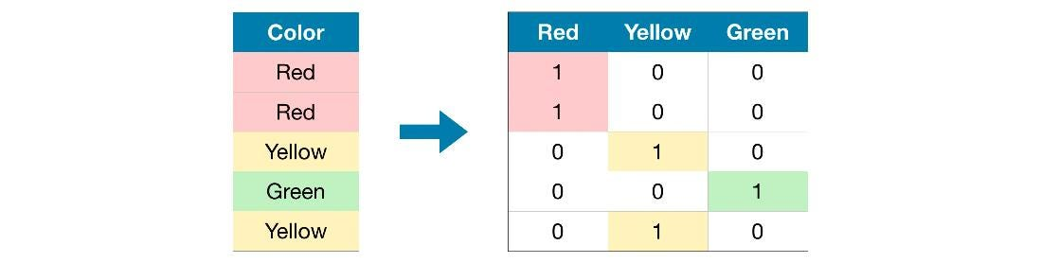
OneHotEncoder
An alternate preprocessing method for categorical variables (text-based strings) for use in a Machine Learning model.
Advantages: lets models integrate categorical variables that can provide more information to the overall model
Disadvantages: models become increasingly complex, which can lead to overfitting and data sparsity

Slide 14
03
Models and Optimization

Slide 15
Model Types
The next step in predicting the data was to determine what type of machine learning model could be effectively used on the data we have. We tested many different model types; chief among them were Random Forest, Linear Regression, Ridge Regression, and Gradient Boosting Regressor.

Slide 16
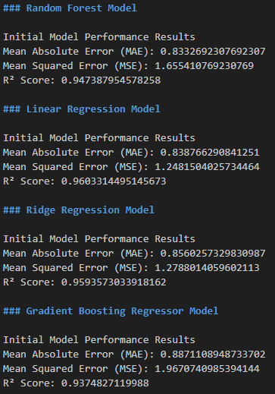
Initial Model Testing
All 4 created models were given their default parameters, trained on the full dataset, and were scored on Mean Absolute Error (MAE), Mean Squared Error (MSE), and R². In the end, the best-working model of these choices was the Linear Regression model.

Slide 17
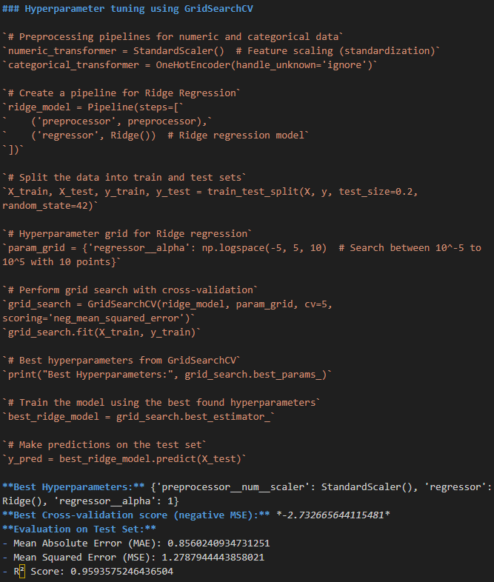
Hyperparameter Tuning
Further testing was done using GridSearchCV to determine the optimal parameters for each model, to get a better grasp on which model would work the best for the data.

Slide 18
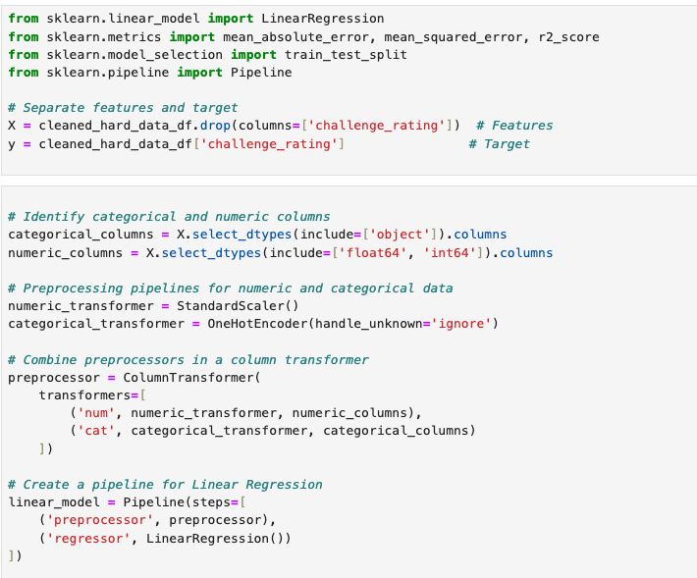
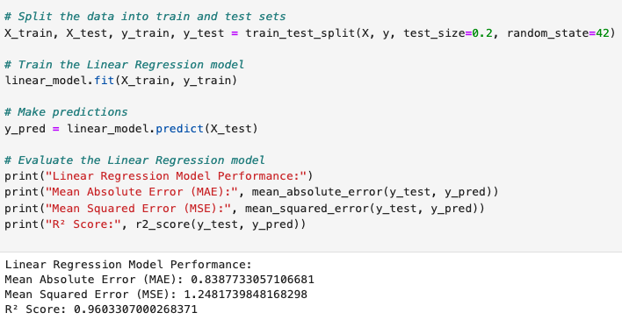
INDUSTRY VALUE CURVE
STRATEGIC MOVE
While the models optimized with GridSearchCV made a strong showing in terms of accuracy, the initial test of the Linear Regression Model ultimately has the best performance stats of all models tested on our data, and should thus be the optimal model to use in our CR prediction software.
Final Model

Slide 19
04
Predicting Monster CR Site
Notes:
Predicting Monster CHallenge Ratings (Live Application)

Slide 20
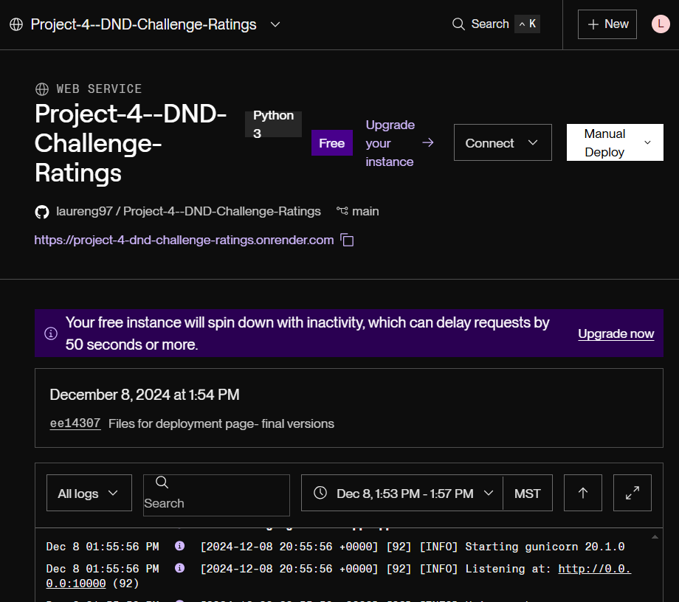
The Live Site
How It Works
Flask Creation and Hosting
Render.com
Github Integration
Render is a cloud platform that allows you to deploy web applications. It builds the web application by pulling the repository and installing dependencies (like the items listed in the requirements.txt file), and then runs your application. Render provides a URLfor the deployed app so that the github deployment is an interactive site (instead of static).
Github is basically the version control system. It hosts all of the code and has automatic deployment. When something is pushed or updated the deployment updates as well. Since render is integrated with github, as long as the HTML file has the correct URL listed within, the site runs dynamically.
The flask is used to pull data from the model we created in order to predict customized challenge ratings for new monsters.
Notes:
We created a live site that allows a user to input different features for a monster, to predict that monster’s challenge rating! We started by making the flask, which uses our linear regression model for predicting CR. I had to host the flask site on a cloud platform called Render. This allows me to have an active web application (url) to integrate into my HTML script. The HTML is listed and deployed through github. Since github is only able to host static sites and we wanted a dynamic site, render was a necessary step we had to take to utilize the model properly.

Slide 21
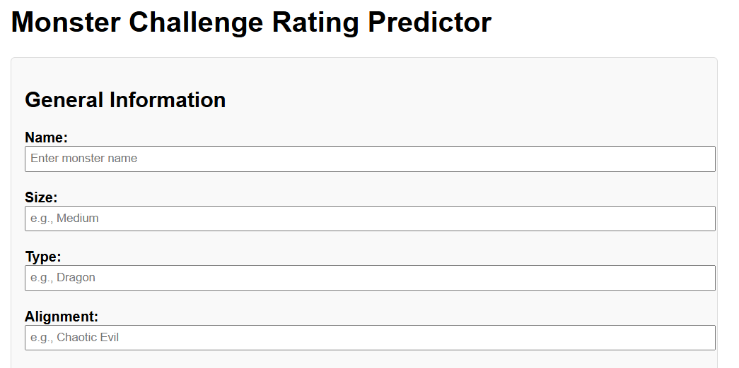
Let’s Test it Out!
DND CR Predictor
Notes:
Lets go ahead and test out the live site! (A quick run through of all the features (pre-filled out), and click the predict button.

Slide 22
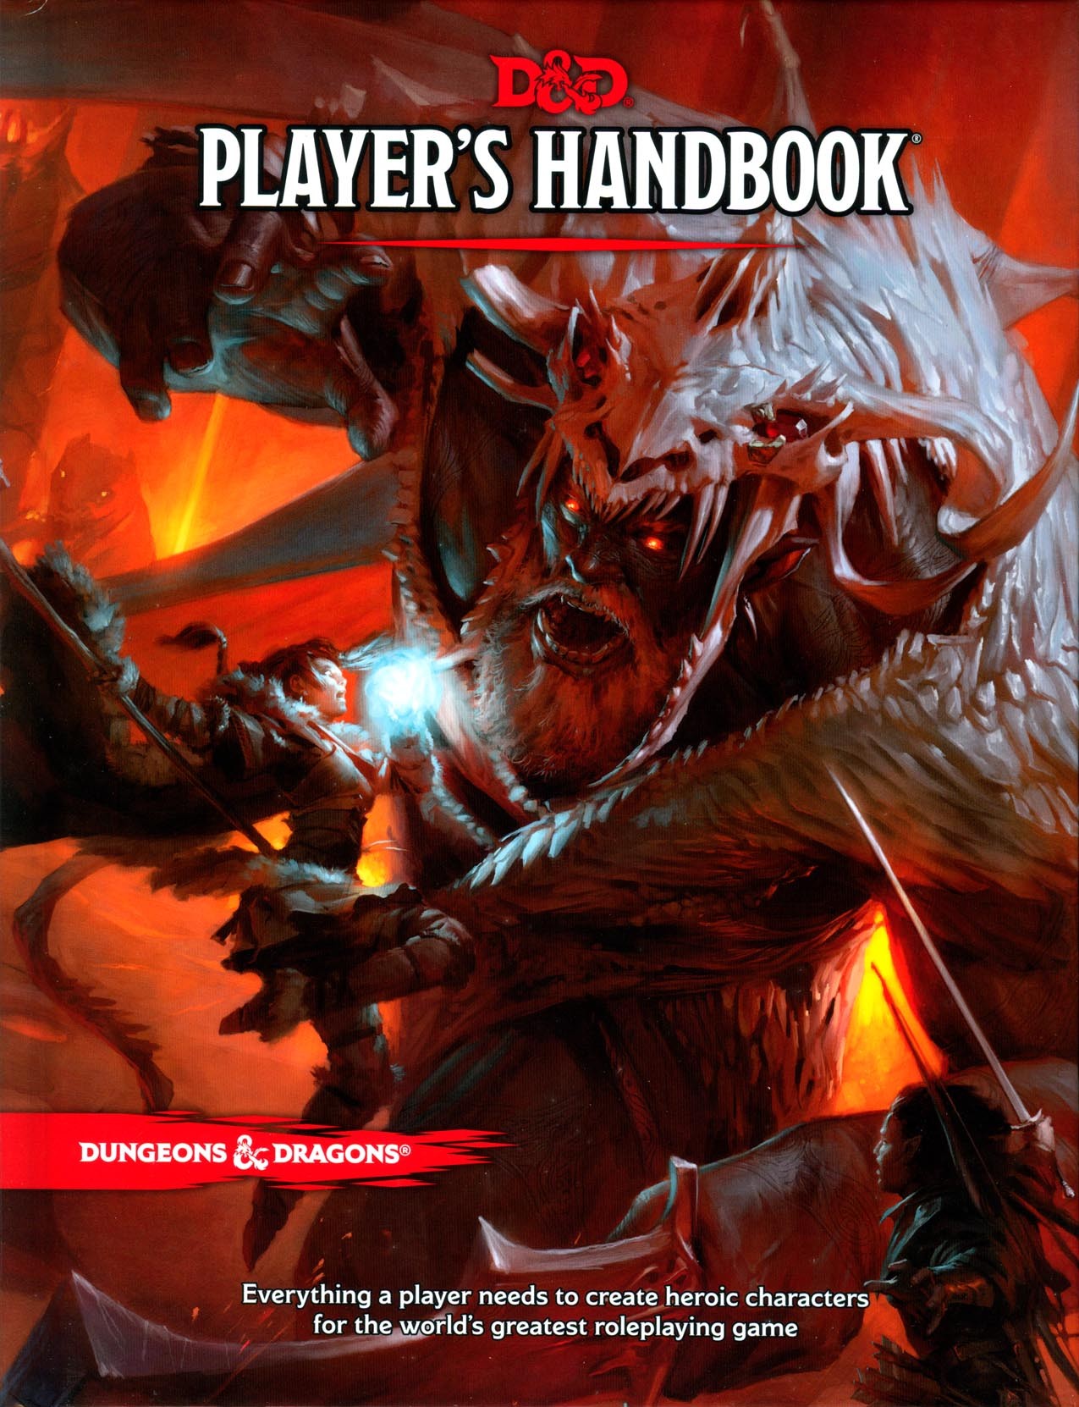
Future Enhancements & Research
While the model has a high accuracy (96%), it is important to note that the site tends to predict monsters at a higher challenge rating, almost all of the time. For future improvements, we would take a look at why this is happening and further adjust the model to improve the challenge rating, such as by expanding the dataset the model trains on with monsters from more sources.
We also could look at implementing a manual challenge rating calculation to compare to the predictive calculation.
Another way of improving the overall goal, would be to delve deeper into NLP (natural language processing) to improve the way the model is interpreting the text based columns.
Notes:
For further research and enhancements, we would want to look at improving our model. It currently sits at 96% accuracy but the site and model itself tend to predict challenge ratings that are higher than their given rating. We could expand the dataset itself to see what other monsters are available to train the data on, or look at implementing a manual challenge rating calculation to compare to the predictive model. In addition, NLP (natural language processing) is a tool that would help improve how the model is interpreting the text based data like actions and reactions.

Slide 23
Questions?

Slide 24
THANK YOU

Slide 25




04
ANDREW POHLE
CAITLIN MCMAHILL
JESSICA MARANTO
LAUREN GRAVES
Primary D&D knowledge base, data preprocessing, Model testing data collection
Model parameter tuning, main code combining and collation, data integration into SQL and database setup
Model parameter tuning
Data preprocessing, Initial model testing, Flask app creator
Team Leadership

